Slide 1
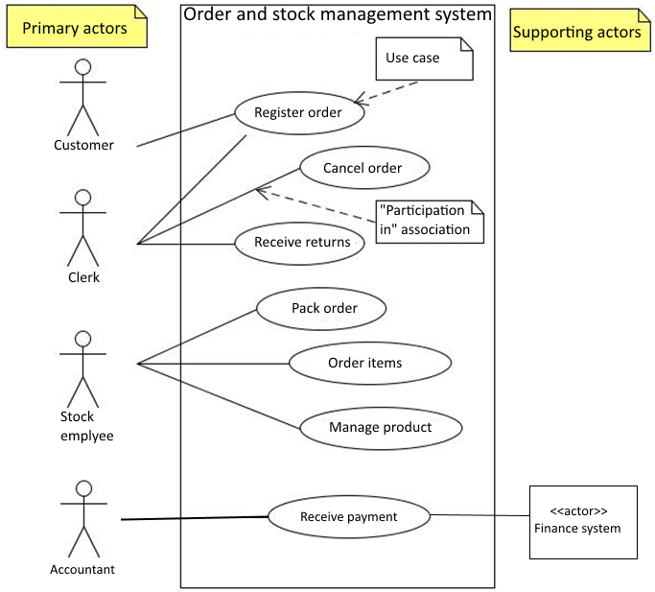
Use Case Diagram for the order and stock management system
A graphical model that illustrates the names of the use cases and actors, and the relationship between them
”A common exception to one use case per goal is to collapse CRUD (create, retrieve, update, delete) seperate goals into one CRUD use case, idiomatically called Manage <X>.” [Larman p. 87]
Larman chap. 6
1

Slide 2
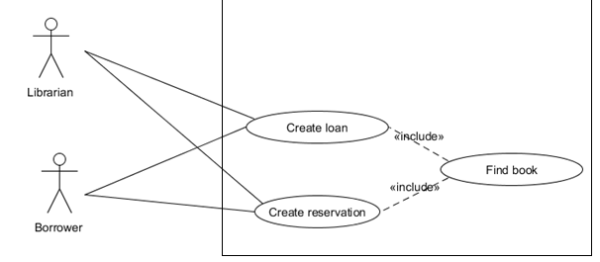
Use Case Diagram – Relating Use cases
Relating Use Cases [Larman] chap. 30
Partial behavior that is common across several use cases can be described in a subfunction-level use case and related to user-goal level use cases by a <<include>> relation:
Example of <<include>> in use case description cf [Larman] p. 494
(Don’t overuse!!!!)
2

Slide 3
Use cases
Use Case driven development
Prioritering
Foretag prioritering af use cases – og følg den
Brug Larman s. 130 – kriterier:
Risk (Technical complexity, ..)
Coverage – all parts of system covered early
Criticality – high business value
3

Slide 4
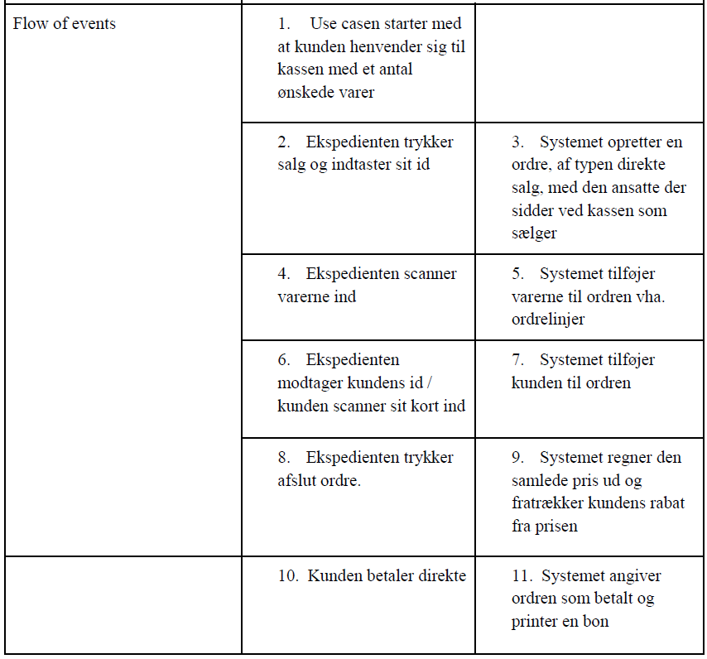
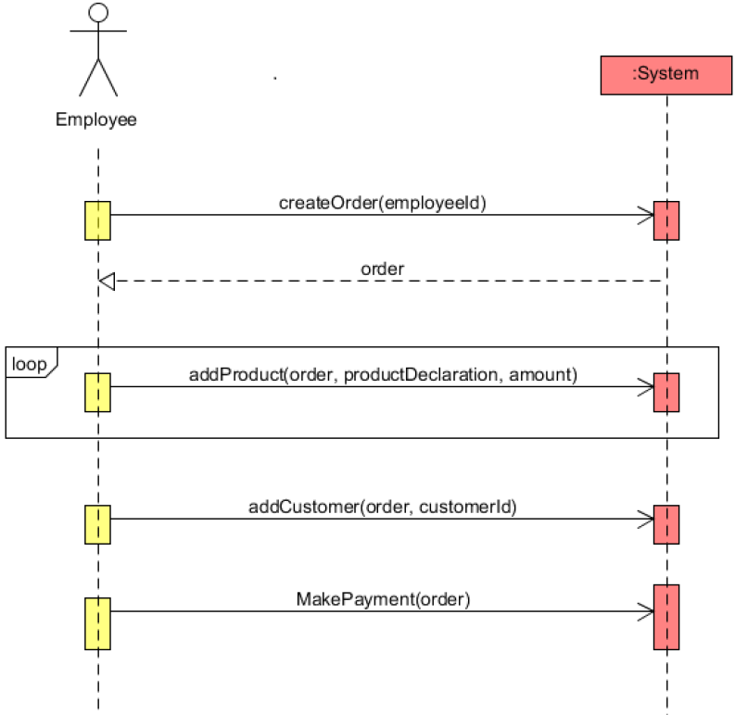
Traceability SD artifacts
Traceability: Fully dressed -> SSD
Notes:
SW project

Slide 5
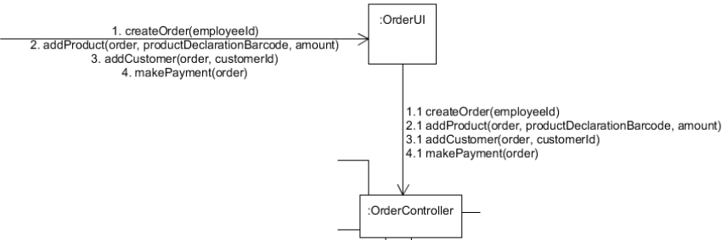
Traceability SD artifacts
Traceability: SSD -> interaction diagram
Notes:
SW project

Slide 6
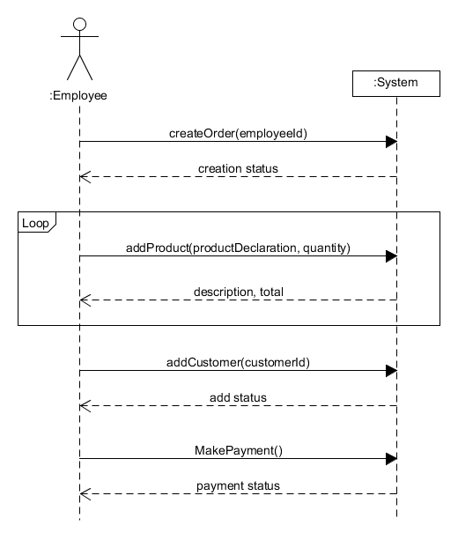
System Sequence Diagram (SSD)
Consider differences!
Notes:
SW project

Slide 7
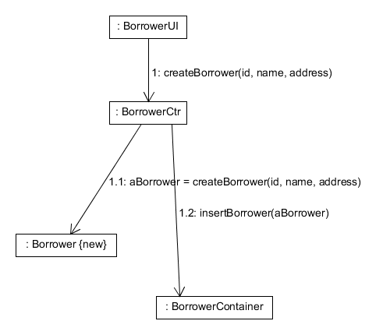
Communication diagram
Consider notation and create responsibility!
Notes:
SW project

Slide 8
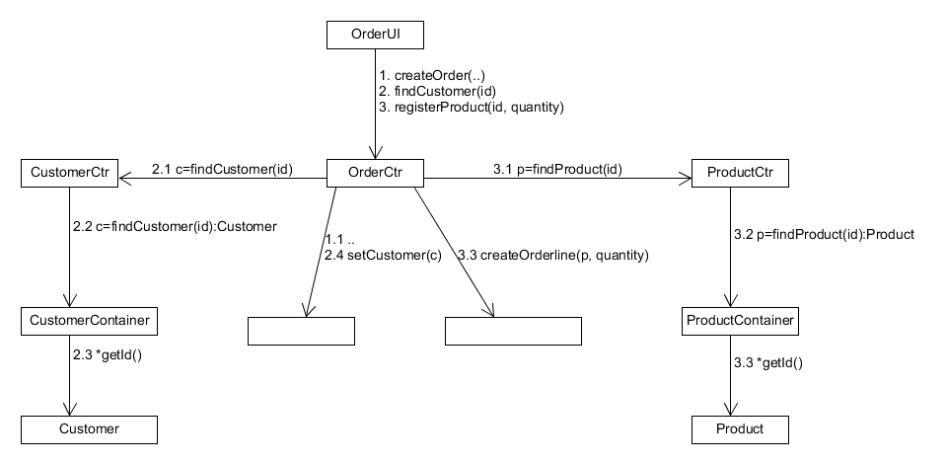
Low Coupling - reuse of controllers
How can you support low dependency between the system components/classes
How can you promote reuse?
We gain low coupling by reusing the CustomerCtr
..
..
and the ProductCtr
8
Litt: larman kap 15, 16 og 19

Slide 9
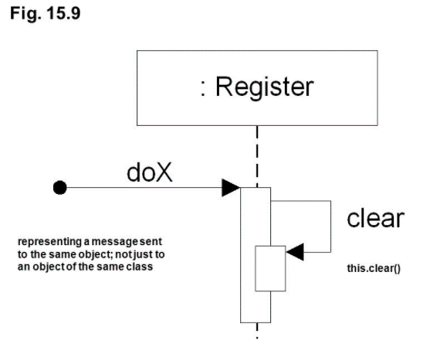
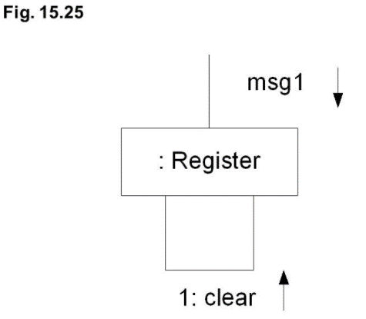
Interaction diagram – self reference
Messages to “self” or “this” – according to Larman
Sequence Diagram
Communication Diagram
9
Litt: larman kap 15, 16 og 19

Slide 10
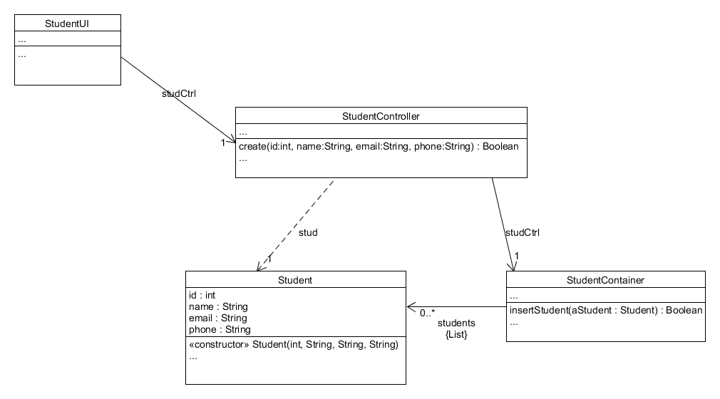
Design Class Diagram

